Slide 1

APPLICATION OF SYSTEM OF LINEAR EQUATIONS
PRESENTED BY MADHURIMA RAWAT ROLL NO-$300012821042$ DATASCIENCE(CSE)
CHHATTISGARH SWAMI VIVEKANANDA TECHNICAL
UNIVERSITY

Slide 2
APPLICATION OF LINEAR EQUATIONS IN COMPUTER SCIENCE ENGINEERING
CRYPTOGRAPHY-
ENCRYPT DECRYPT
MESSAGE CIPHER TEXT MESSAGE
HELLO
WORLD
JGNNQ
YQTNF
HELLO
WORLD

Slide 3
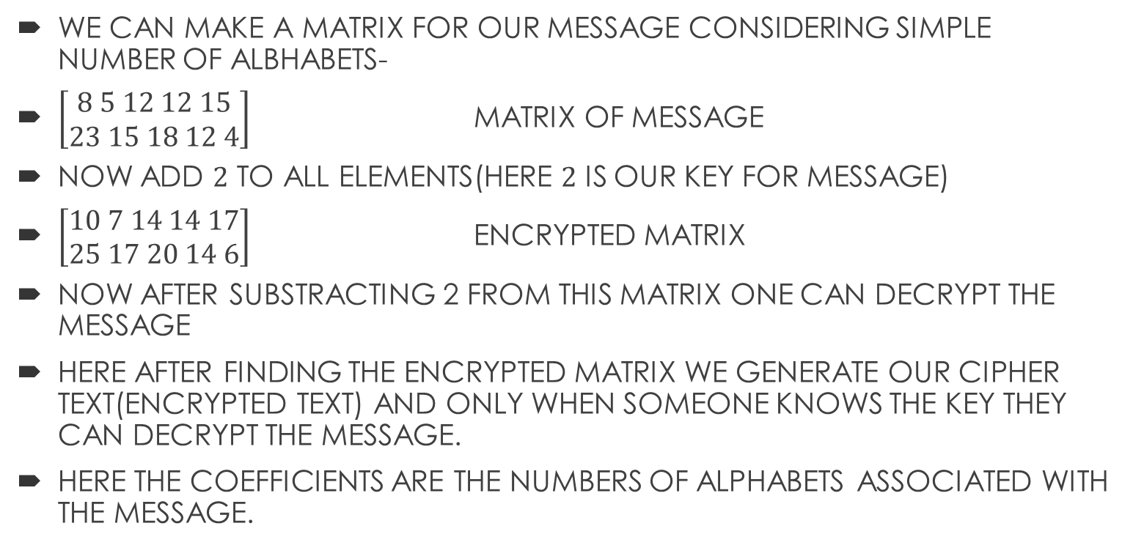
HOW IS LINEAR EQUATIONS APPLIED IN THIS
WE CAN MAKE A MATRIX FOR OUR MESSAGE CONSIDERING SIMPLE NUMBER OF ALBHABETS-
$\left[\begin{aligned}8 5 12 12 15 \\ 23 15 18 12 4\end{aligned}\right]$ MATRIX OF MESSAGE
NOW ADD $2$ TO ALL ELEMENTS(HERE $2$ IS OUR KEY FOR MESSAGE)
$\left[\begin{aligned}10 7 14 14 17 \\ 25 17 20 14 6\end{aligned}\right]$ ENCRYPTED MATRIX
NOW AFTER SUBSTRACTING 2 FROM THIS MATRIX ONE CAN DECRYPT THE MESSAGE
HERE AFTER FINDING THE ENCRYPTED MATRIX WE GENERATE OUR CIPHER TEXT(ENCRYPTED TEXT) AND ONLY WHEN SOMEONE KNOWS THE KEY THEY CAN DECRYPT THE MESSAGE.
HERE THE COEFFICIENTS ARE THE NUMBERS OF ALPHABETS ASSOCIATED WITH THE MESSAGE.

Slide 4
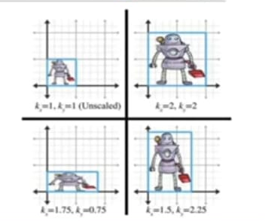
IN COMPUTER GRAPHICS
CONTRACTION AND EXTRACTION
CAN BE DONE BY CHANGING VALUES OF COEFFICIENTS-
IN FIRST IMAGE,THE COEFFICIENTS OF OBJECTS
IS SET AS 1 ,THE OBJECT IS SMALLER AND AS
WE VARY THE COEFFICIENTS THE IMAGE IS
CONTRACTED OR EXTRACTED DEPENDING
UPON THE VALUES
THUS WITH LINEAR EQUATIONS WE CAN
ZOOM IN AND OUT ANY OBJECT JUST BY
CHANGING THE COEFFICIENTS

Slide 5
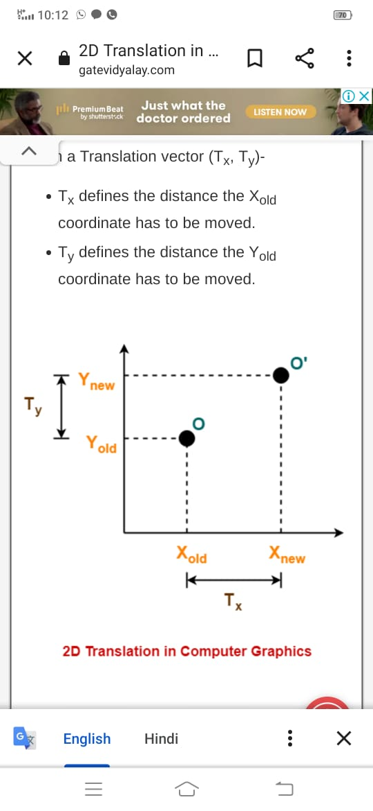
TRANSLATION(MOVEMENT)
Consider a point object O has to be moved from one position to another in a 2D plane.
Let-
Initial coordinates of the object O = (X_{old}, Y_{old})
New coordinates of the object O after translation = (X_{new}, Y_{new})
Translation vector or Shift vector = (T_{x}, T_{y})
Given a Translation vector (T_{x}, T_{y})-
T_{x} defines the distance the X_{old} coordinate has to be moved.
T_{y} defines the distance the Y_{old} coordinate has to be moved.

Slide 6
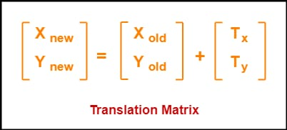
HOW IT IS DONE
This translation is achieved by adding the translation coordinates to the old coordinates of the object as-
X_{new} = X_{old} + T_{x} (This denotes translation towards X axis)
Y_{new} = Y_{old} + T_{y} (This denotes translation towards Y axis)
In Matrix form, the above translation equations may be represented as-

Slide 7
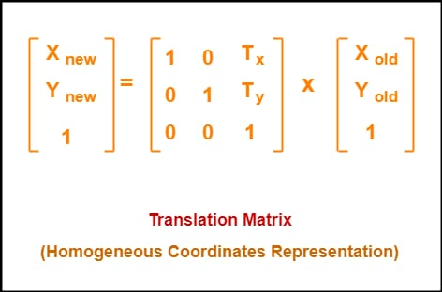
HOW IT IS DONE
The homogeneous coordinates representation of (X, Y) is (X, Y, 1).
Through this representation, all the transformations can be performed using matrix / vector multiplications.
The above translation matrix may be represented as a 3 x 3 matrix as-

Slide 8
ANIMATIONS
The computer animations seen in movies and videogames works in three stages:
A 3D model of the scene objects is created;
The model is converted into (many small) polygons in 3D that approximate the surfaces of the model; and
The polygons are transformed via a linear transformation to yield a 2D representation that can be shown on a flat screen.
There is interesting mathematics in each stage, but the transformations that take place in the third stage are linear.

Slide 9
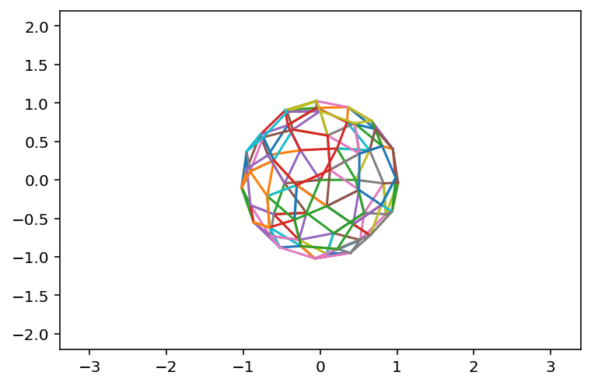
HOW IT WORKS
The resulting representation consists of lists of 3D coordinates called faces. Each face is a polygon.
Here is a view of a ball-like object. It is centered at the origin.
The ball is represented in terms of 3D coordinates, but we are only plotting the x and y coordinates here. Colors correspond to faces.

Slide 10
AEROSPACE ENGINEERING
Linear Algebra is majorly used in Aerospace Engineering in its applications in matrices and vectors and operations and transformations on them. The fundamental reason why matrices even come up in the field is because we deal with a 3-D space. Any vector will hence have multiple components. Say velocity will usually be
V=[vx vy vz]TV=[vx vy vz]T
or acceleration may be a=[ax ay az]Ta=[ax ay az]T

Slide 11
EXACT APPLICATION
The Aerodynamicist: Simulation of flows around objects like wings and aircraft fuselages require solving equations called the Navier Stokes equations that govern fluid flow.
The Structures Expert: Analyzing stresses on structural elements like beams and aircraft skins are usually done by hypothetically breaking down the whole thing into small elements and solving equations on them individually. These involve solutions of large matrix systems and linear algebra plays a huge role.
The Propulsions Analyst: Simulation of combustion, heat flows, temperature distributions, projectile motion are usually done by converting them into sets of linear equations that can be solved analytically .
The Dynamics & Controls Specialist: A lot of control theory involves deriving non-linear models of systems, converting them into linear models and applying control laws to it to produce desired outputs by providing specific inputs. Eigen-vectors and eigen values, vector algebra, matrix transformations - all parts of linear algebra, are used extensively here.

Slide 12
ECONOMICS
Financial Analyst
Financial occupations often require the use of linear equations. Accountants, auditors, budget analysts, insurance underwriters and loan officers frequently use linear equations to balance accounts, determine pricing and set budgets. Linear equations used in financial occupations may also be used in creating family budgets as well.

Slide 13
HEALTHCARE
Health Care Professional
The health care field, including doctors and nurses, often use linear equations to calculate medical doses. Linear equations are also used to determine how different medications may interact with each other and how to determine correct dosage amounts to prevent overdose with patients using multiple medications. Medicine production units also uses linear equations to calculate the formula of medicinal drugs(medicinal composition).

Slide 14
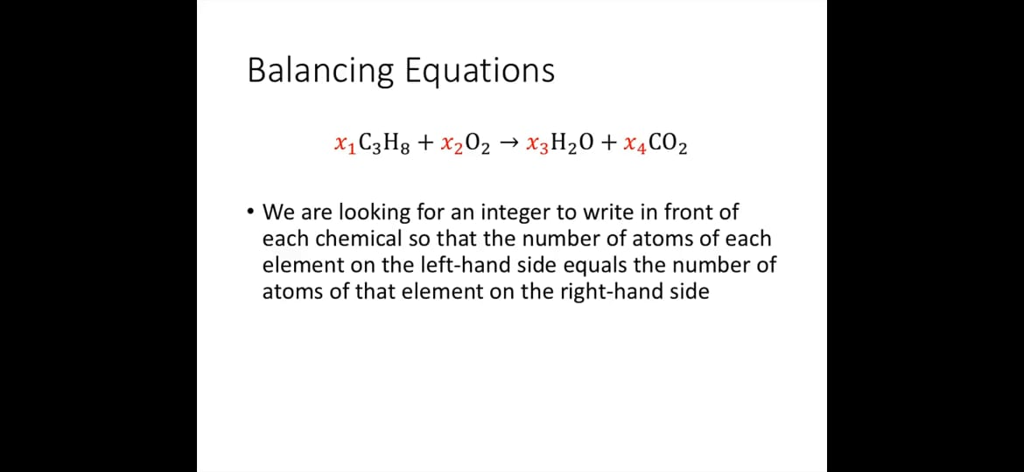
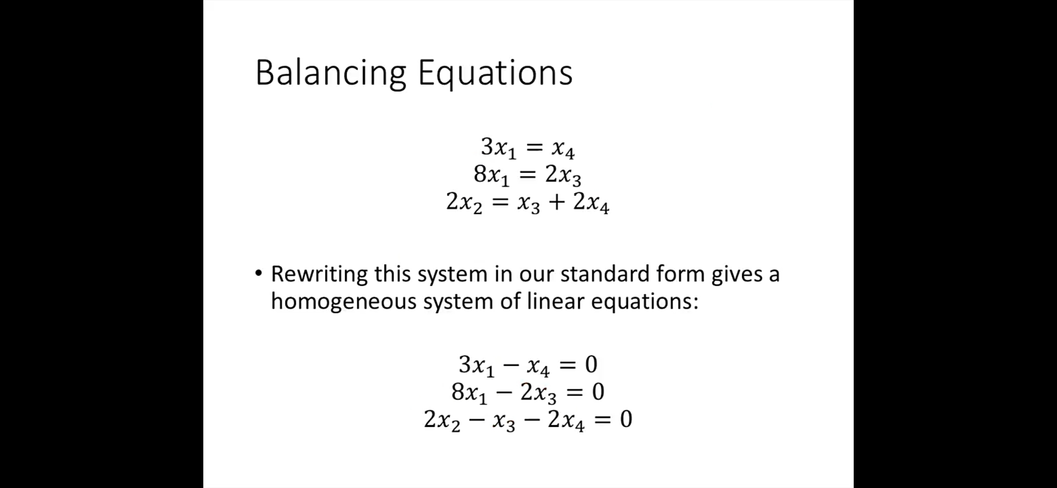
CHEMISTRY
It can be used to balance a chemical equation so that reactant= product in order that nothing is mysteriously lost or gained.

Slide 15
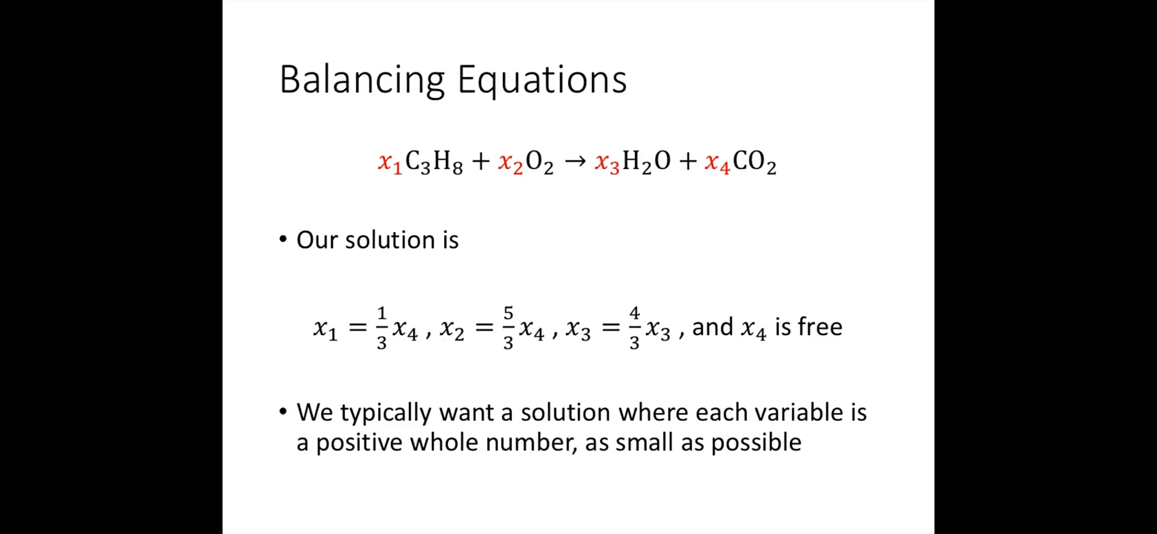
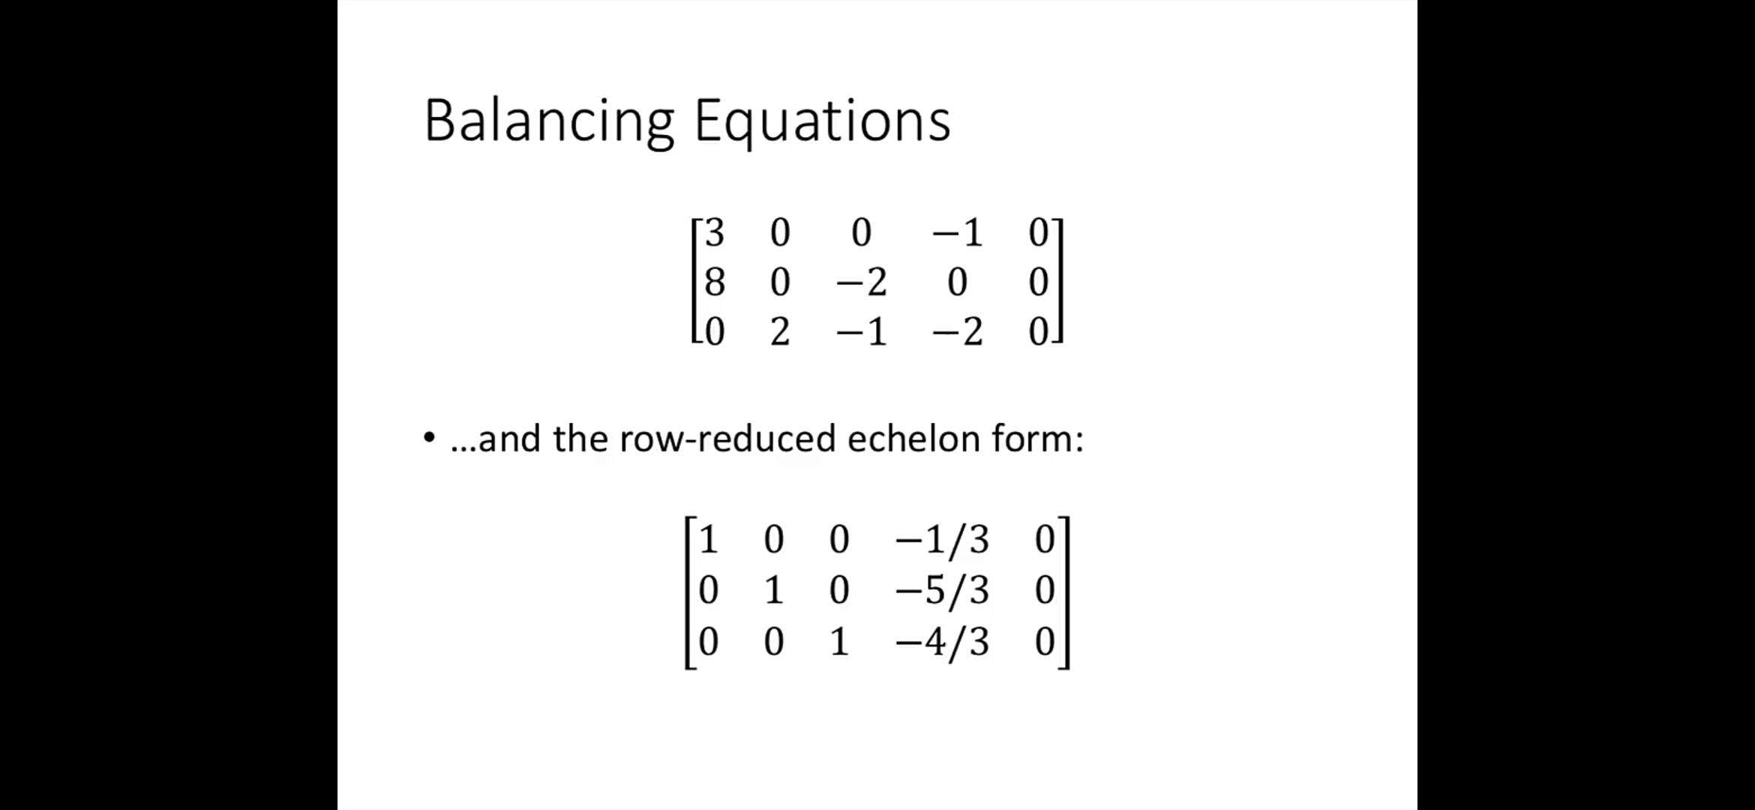
SOLUTION OF EQUATION FORM

Slide 16
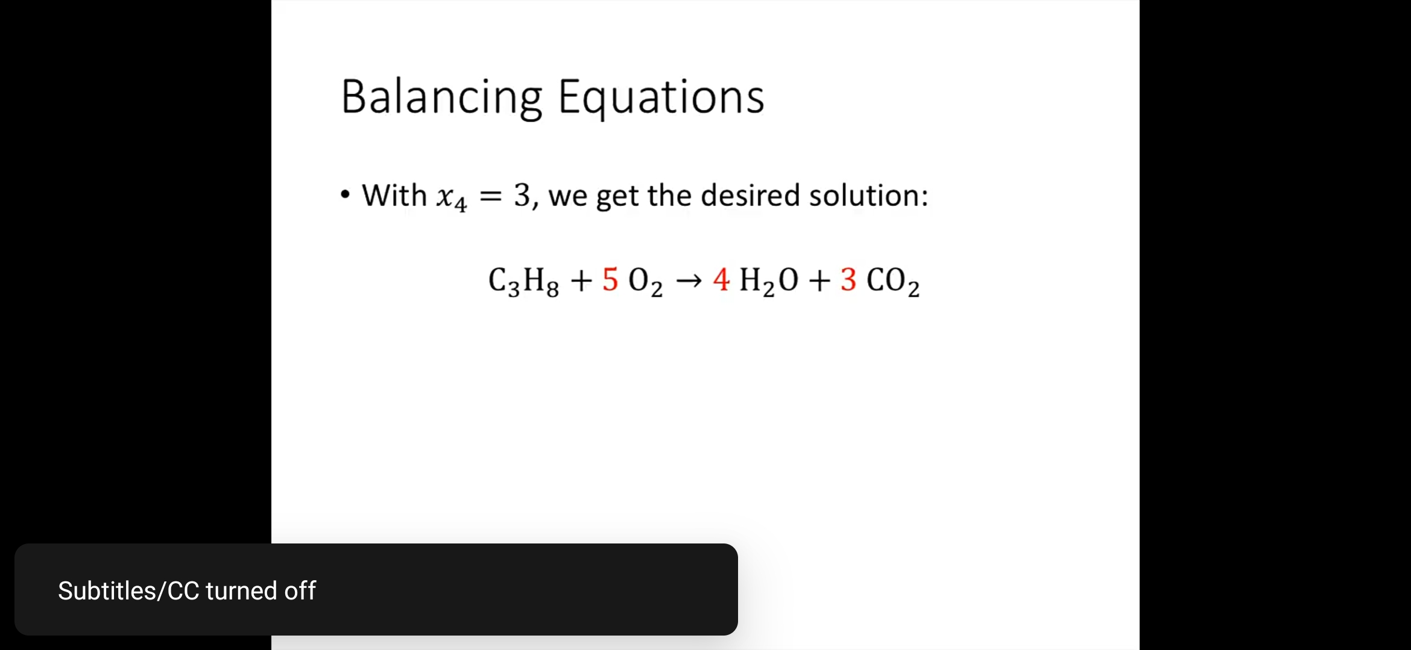
FINAL SOLUTION
WE NEED TO FIND A WHOLE NUMBER WHICH SATISFIES THE CONDITIONS:
SINCE IN THIS EQUATION ALL VARIABLES HAVE 3 AS DENOMINATOR WE TAKE VALUE OF X4 BE 3 AND IT SATISFIES THE CONDITION THUS ALL VALUES ARE FOUND TO BE x1=1,x2=5,x3=4 and x4=3
ONE MORE IMPORTANT THING IS THAT IN THIS CASE INFINITELY MANY SOLUTIONS ARE POSSIBLE AND WE HAVE TAKEN THE SMALLEST POSSIBLE ONE.

Slide 17
THANK YOU FOR LISTENING TO ME
ANY QUESTIONS

